Slide 1
Final Project Presentation
Pruthul Patel
Keshav Patel

Slide 2
Description of the Data
Dataset contains 2126 records of features extracted from Cardiotocogram(CTG) exams.
Classified by three expert obstetricians into 3 classes:
Normal
Suspect
Pathological

Slide 3
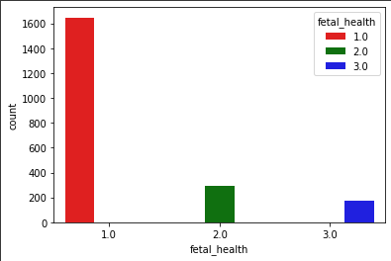
Task 1
Balanced data using Stratification Random Over Sampling Method.

Slide 4
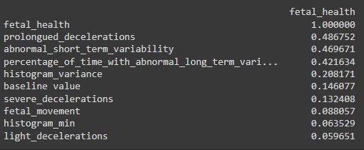
Task 2

Slide 5
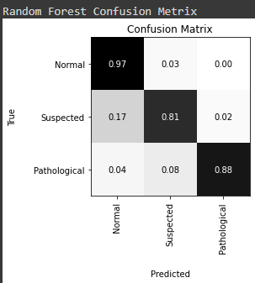

Task 4

Slide 6
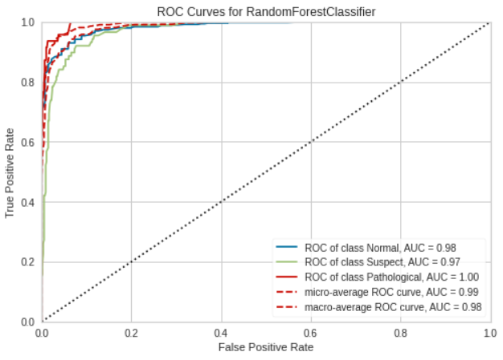
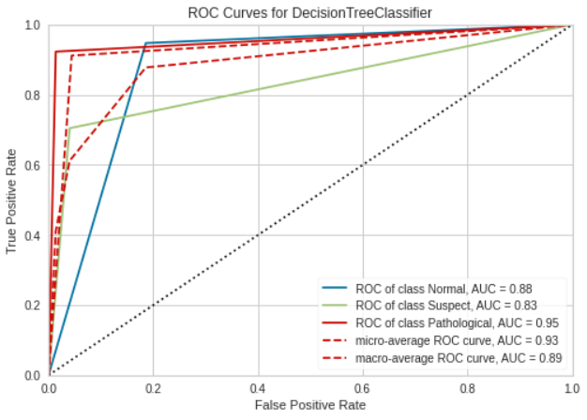
Task 5

Slide 7
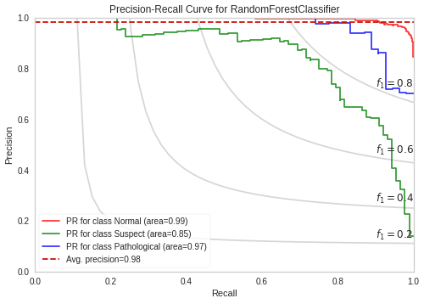
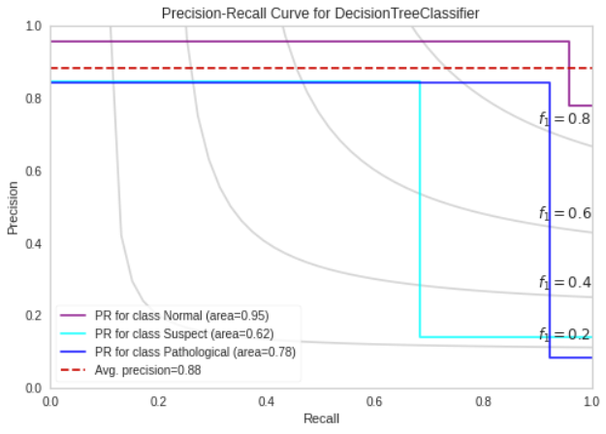
Task 5

Slide 8
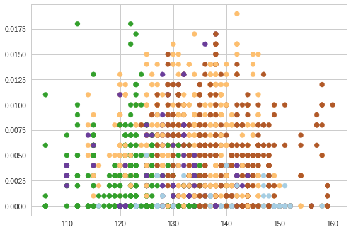
Task 6 K=5

Slide 9
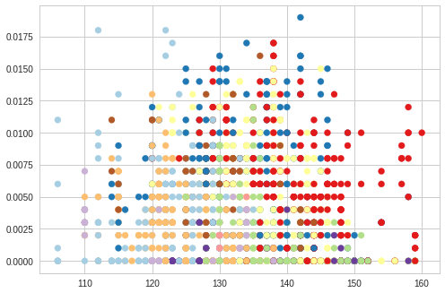
K=10

Slide 10
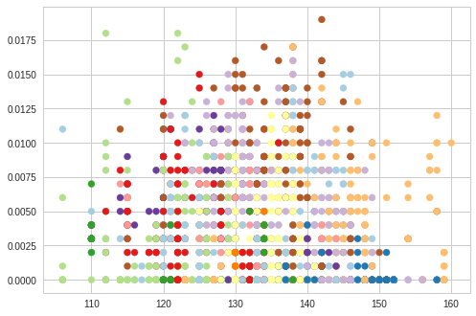
k=15

Slide 11
Who Did What
Harshkumar Patel :
Task 1
Task 3
Task 5
Dharmik Soni:
Task 2
Task 4
Task 6

Slide 12
Conclusion
Present visual distribution of 3 classes and found data is imbalance.
Present 10 features that are most reflective to fetal health conditions.
Visually present the confusion matrix using two model (Random Forest Classifier and Decision Tree Classifier).
With a testing set of size of 30% of all available data
Area Under the ROC Curve
F1 Score
Area Under the Precision Recall Curve
Clusters
Visualize by K = 5, 10, 15

